Slide 1

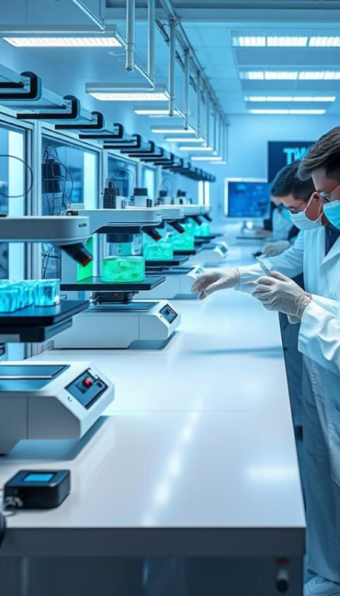
VAAGDEVI ENGINEERING COLLEGE
TECHNICAL SEMINAR
ON
BIOPRINTING: A STRATEGY TO BUILD INFORMATIVE MODELS OF EXPOSURE AND DISEASE
CHELAMALLA MANIKANTA
21UK1A0559
CSE-A

Slide 2
What is Bio Printing?
Building Biology Layer by Layer
From Cells to Structures
Bio printing, also known as 3D bioprinting, is a cutting-edge technology that uses specialized 3D printers to create living tissues and organs from biological materials. It involves precisely depositing cells, bioinks, and growth factors onto a scaffold, layer by layer, to build functional, three-dimensional structures that mimic natural tissues.
Think of it as printing with living building blocks. Bio printers use computer-aided designs to guide the process, ensuring the creation of complex structures with controlled geometry and cell distribution. This ability to control the architecture of biological materials opens up a wide range of possibilities for regenerative medicine and tissue engineering.

Slide 3
History and Evolution of Bio Printing
Present
1980s
Bio printing continues to evolve rapidly with the emergence of new bioinks, printing techniques, and applications, pushing the boundaries of regenerative medicine and tissue engineering.
Early research on 3D printing techniques for creating tissues and organs began in the 1980s, laying the foundation for the field of bio printing.
1
2
3
2000s
Significant advancements in bioprinting technology emerged, including the development of biocompatible bioinks and the ability to print complex structures with controlled cell distribution.

Slide 4
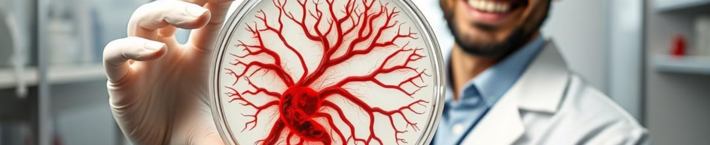
Advantages of Bioprinting in Exposure and Disease Modeling
1
Personalized Medicine
2
Reduced Animal Testing
3
Enhanced Understanding
Tailored models for individual patient response
Ethical and cost-effective alternative
In-depth insight into disease mechanisms and treatment effects

Slide 5
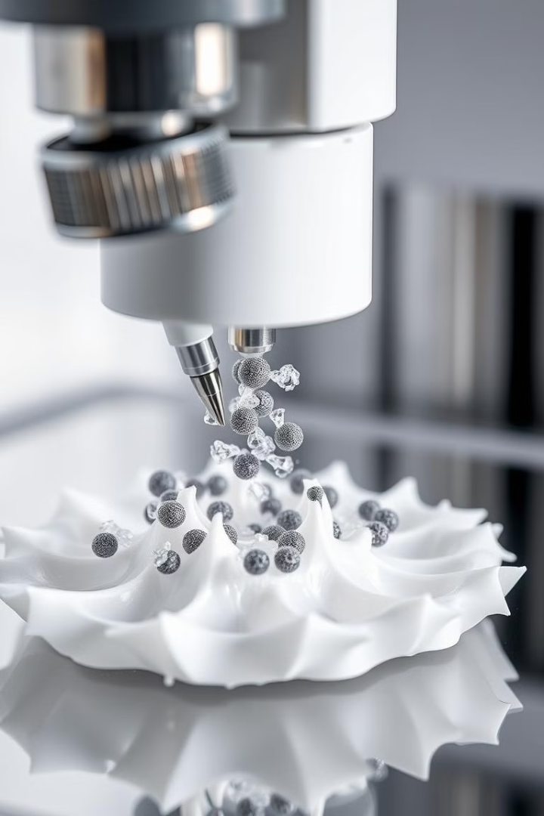
Bioprinting Techniques: From Simple to Complex Structures
1
Extrusion: depositing bioink through a nozzle
2
Inkjet Printing: spraying bioink droplets onto a scaffold
3
Laser-Assisted Bioprinting: using lasers to direct cell deposition

Slide 6
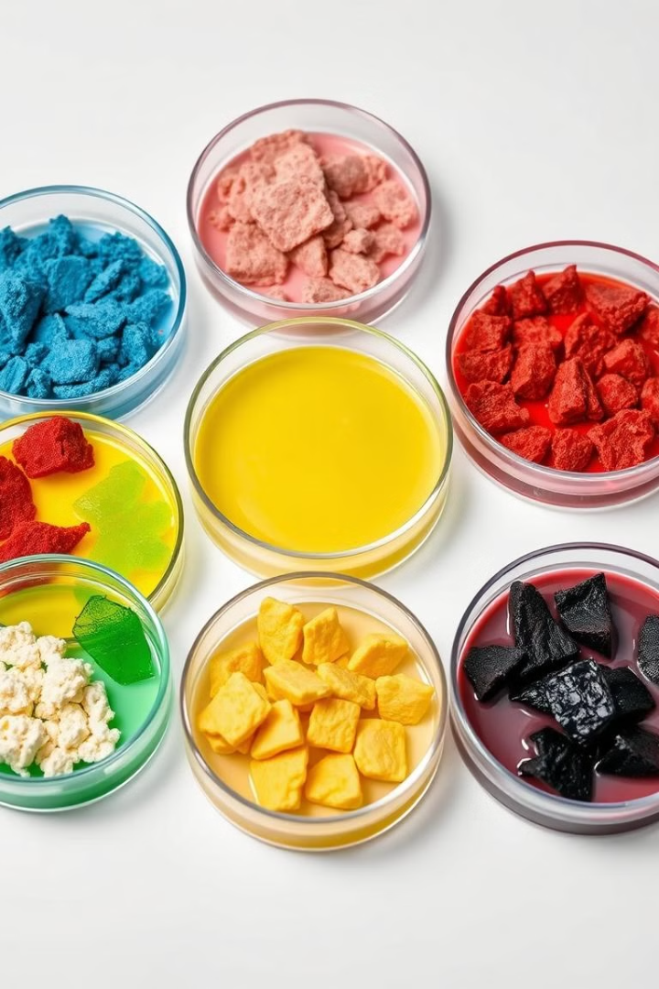
Bioink Formulations for Tissue-Specific Applications
Hydrogels
Bioceramics
Water-based materials, mimicking the natural extracellular matrix
Strong and biocompatible, suitable for bone regeneration
Decellularized Matrices
Natural scaffolds derived from animal or human tissues

Slide 7
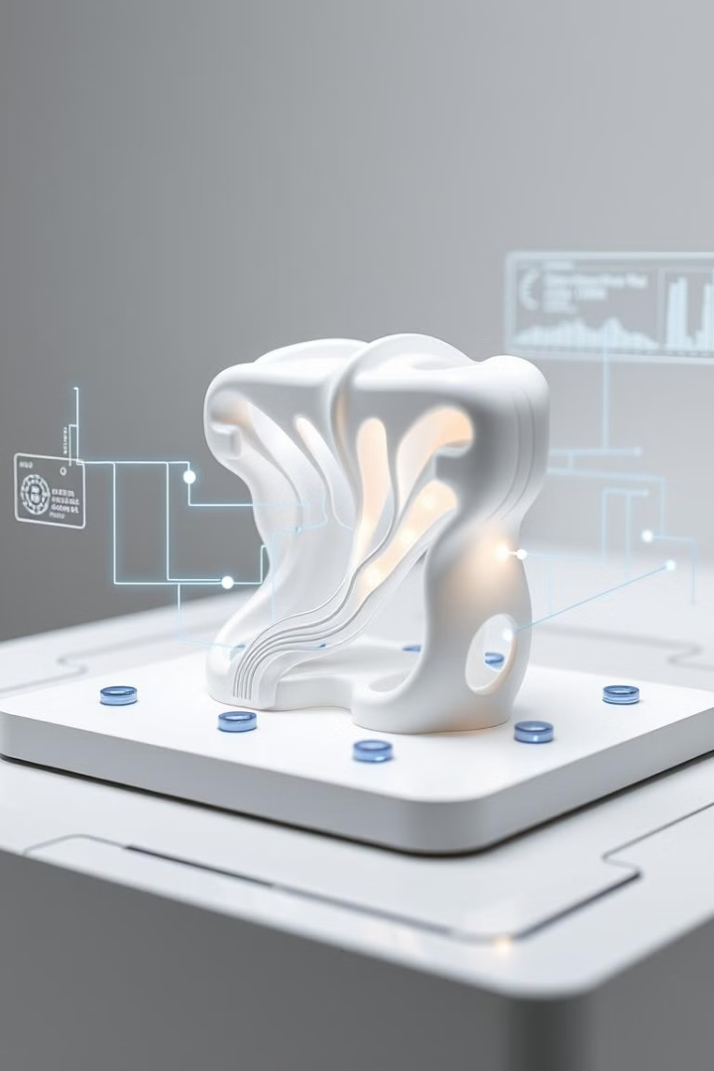



Integrating Sensing Capabilities for Exposure Assessment
Microfluidic Sensors
Optical Sensors
Measure chemical and physical parameters within the model
Monitor cell viability and activity
Electrochemical Sensors
Detect biomolecular interactions and changes

Slide 8



Developing 3D Vascularized Tissue Models
Microfluidic Channels
1
Simulate blood flow and nutrient transport
Biocompatible Polymers
2
Support vascular structure and function
Cell-Based Bioprinting
3
Incorporating endothelial and smooth muscle cells

Slide 9
Recapitulating Disease Pathophysiology In Vitro
Cancer Models
1
Study tumor growth and response to therapy
Inflammatory Disease Models
2
Investigate the mechanisms of immune system activation
Neurodegenerative Disease Models
3
Explore the progression and potential treatments

Slide 10
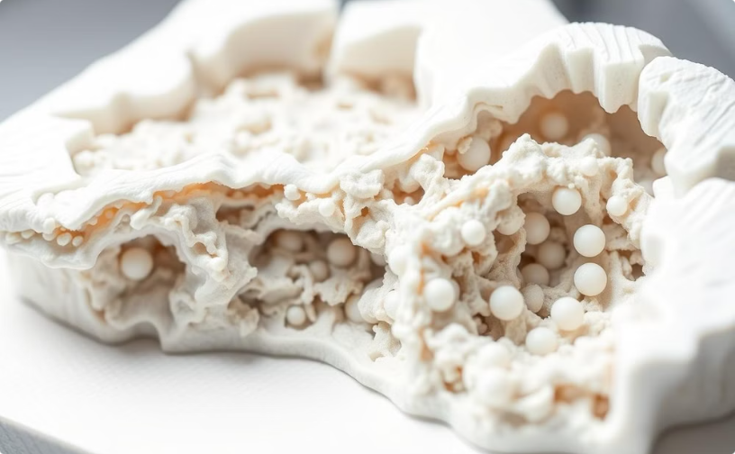
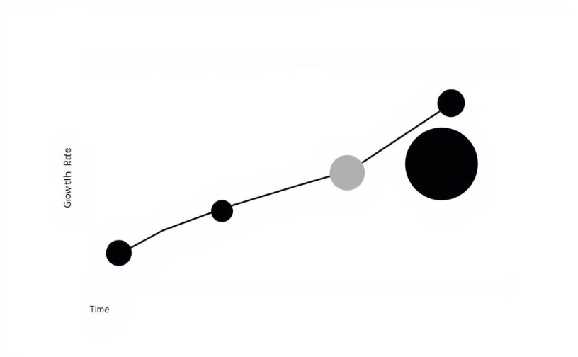
Challenges and Limitations of Bioprinted Exposure and Disease Models
Cell Viability and Function
Standardization and Validation
Ensuring long-term cell survival and activity
Developing protocols for reproducible and reliable results

Slide 11
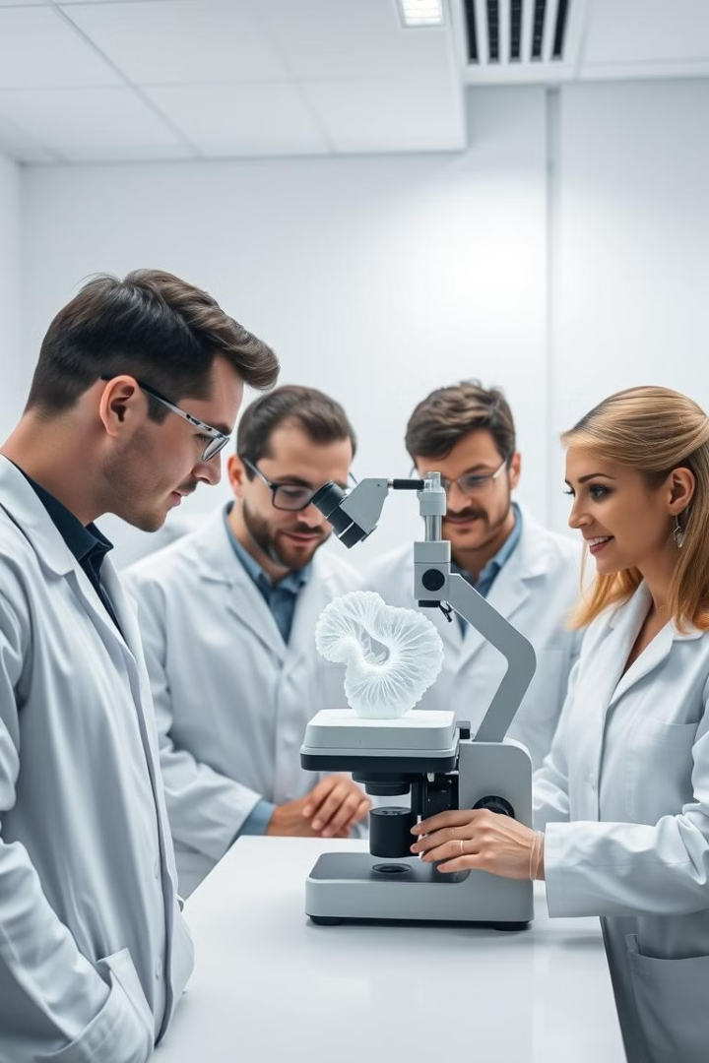
Conclusion
Bioprinting offers a transformative approach to disease modeling and drug discovery, paving the way for personalized medicine and accelerated research.

